Slide 1
NLP for Electronic Health Records
11/5/2020
Tony Wong

Slide 2
OVERVIEW

Slide 3
Datasets in EHR
MIMIC-III: free, publicly accessible database of de-identified medical information for patients who stayed at Beth Israel Deaconess Medical Center between 2001 and 2012
MIMC-CXR: de-identified 377,000 radiology images of chest X-rays. Classified into 14 different labels
PubMed: Corpus with more than 30 million citations for biomedical and scientific literature. Includes books, papers and biomedical articles:
WikiMed and PubMedDS: entity linking
Notes:
Other datasets used in my model?

Slide 4
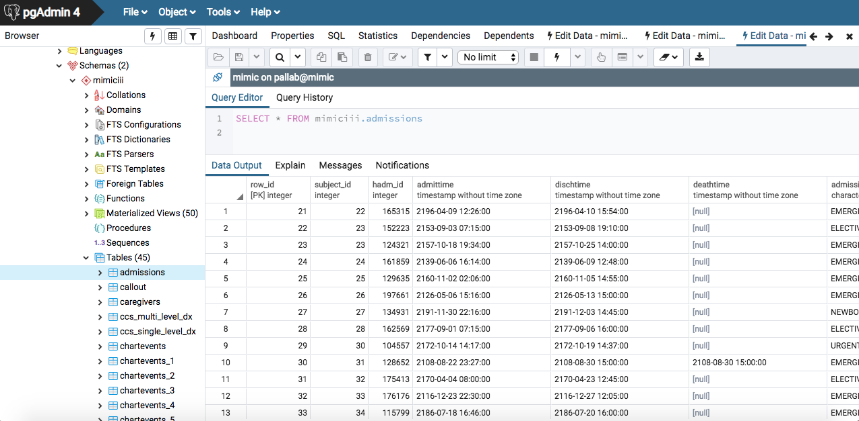
MIMIC dataset: example

Slide 5
ICD Coding
ICD stands for International Classification of Diseases
The official system of assigning codes to diagnoses and procedures in US hospital utilization
Consists of
Tables containing a numerical list of disease code numbers in tabular form
System of classification for surgical, diagnostic, and therapeutic procedures
Alphabetical index to disease entries

Slide 6
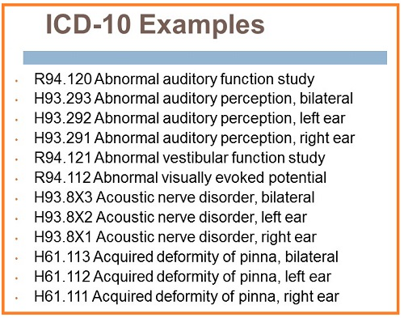
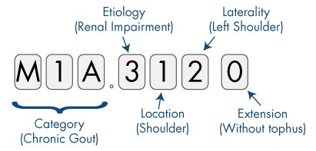
ICD 10 (10th Revision)
References:
https://www.aapc.com/icd-10/conversion-mapping.aspx
https://www.audiologyonline.com/articles/billing-and-coding-2015-update-14038

Slide 7
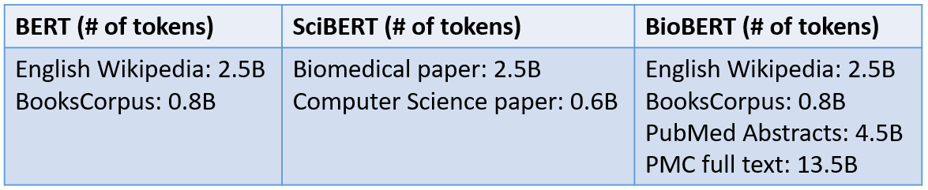
Pretrained Models
BioBERT: PubMed Abstracts, PMC Full Text
Reference:
https://towardsdatascience.com/how-to-apply-bert-in-scientific-domain-2d9db0480bd9

Slide 8
Representation Learning
Concept Embeddings
Patient Embeddings
EHR Embeddings

Slide 9
Representation Learning
Concept embedding
Learning the semantics of medical concept, e.g. genes, proteins, diseases
Cui2vec learns from 80 million documents of insurance claims, journal articles and clinical notes
Graph-based Attention Model gives EHR with hierarchical information from medical ontologies via mechanism mechanism. Each concept embedding is informed by background knowledge

Slide 10
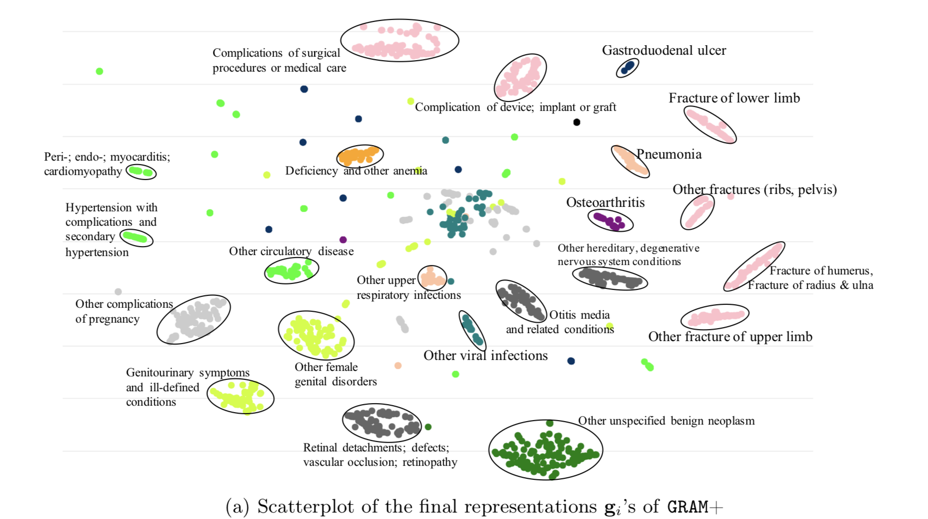
Concept Embedding: Example
Reference: https://arxiv.org/pdf/1611.07012.pdf

Slide 11
Representation Learning
(2) Patient Embeddings:
Merabi: Patient Node as a Matrix. Rows: Medical Codes, Columns: Years
Deep Patient: Each patient is represented with a single vector or sequence determined by temporal windows
Patient2Vec: Each patient visit as a sequence of ICD-9 codes, mediations and lab tests
TAPER: text and medical codes to produce unified representation from patient’s visit data

Slide 12
EHR Embeddings
Embeddings of Clinical Notes
EHRBERT: trains on nonpublic data
MT-ClinicalBERT: learning embeddings of clinical text and performs multitask learning
BHERT: Deep neural transduction to learn about patient’s past diseases their relationships
CheXBERT: Used to label radiology reports

Slide 13
Information Extraction
Event Extraction
Relation Extraction
Named Entity Recognition
Entity Linking

Slide 14
Information Extraction
Event Extraction
Detecting different types of events
HYPE:
Jagannatha and Yu et. al: LSTM to extract Acute Myocardial Infection cases
Extract symptoms

Slide 15
Information Extraction
(2) Relation Extraction
Extracts the entities in a text that share a given condition

Slide 16
Relation Extraction
(3) Named Entity Recognition
Linking each mention to a broad category
E.g. “Paris” - City? Person?

Slide 17
Relation Extraction
(4) Entity Linking
More fine-grained task: Linking each mention to an entity
Paper: MEDTYPE

Slide 18
Classification
Medical Coding
Segmentation
Disambiguation
De-identification

Slide 19
Classification
Medical Coding
Mapping electronic health records to ICD (international coding of disease), where each code represent a diagnosis. These codes help physicians quickly diagnose diseases and they are used in clinical treatment and medical billing
Mapping manually is tedious and error-prone (too detailed), which can have serious consequences
Deep Learning: BERT

Slide 20
Classification
(2) Segmentation
Marking boundaries of EHR text
Topic Segmentation: separate into sections corresponding to different topics

Slide 21
Classification
(3) Disambiguation
Word sense
Medical jargons overlapping with ordinary meaning of the word
“Ice”: frozen water, methamphetamine or caspase-1
Abbreviation

Slide 22
Medical Outcome Prediction
Doctor AI: model predicting new diagnoses and medications for subsequent visit of a patient
Models used: LSTM, CNNs etc.

Slide 23
Classification
(4) De-identification
The Health Insurance Portability and Accountability Act (HIPAA) includes 18 types of protected health information (PHI). They include: names, locations, phone numbers etc.

Slide 24
Classification
De-identification
Clinical notes contain explicit personal health information which might cause privacy issue when trying to release public datasets for machine learning purposes. This contradicts the guidelines HIPPA. Deidentification becomes necessary.
More specifically, need to get rid of names of patients, proxies, identification numbers, hospital names and locations, geographic locations and dates. It is a huge burden to manually de-identify using some manuals.
Techniques: NER, CRC
Notes:
Clinical notes contain explicit personal health information which might cause privacy issue when trying to release public datasets for machine learning purposes. This contradicts the guidelines HIPPA. Deidentification becomes necessary.
More specifically, need to get rid of names of patients, proxies, identification numbers, hospital names and locations, geographic locations and dates. It is a huge burden to manually de-identify using some manuals.

Slide 25
Classification
Techniques: De-identification can be interpreted as a traditional named-entity recognition (NER)
Goal to identify proper output sequence of entities
Rule-based
Feature-based
Neural method
Notes:
https://medium.com/nedap/de-identification-of-ehr-using-nlp-a270d40fc442

Slide 26
De-identification
De-identifier built with CRF (Conditional Random Fields) model
Each clinical record tokenized using tokenizer, and features are extracted for each token
Character-enhanced token embedding layer maps each token to a vector representation, then each sequence of vector representations corresponding to sequence tokens inputted into label-prediction layer
Lastly, sequence-optimization layer outputs the most likely sequence of predicted labels based on sequence of probability vectors from previous layer

Slide 27
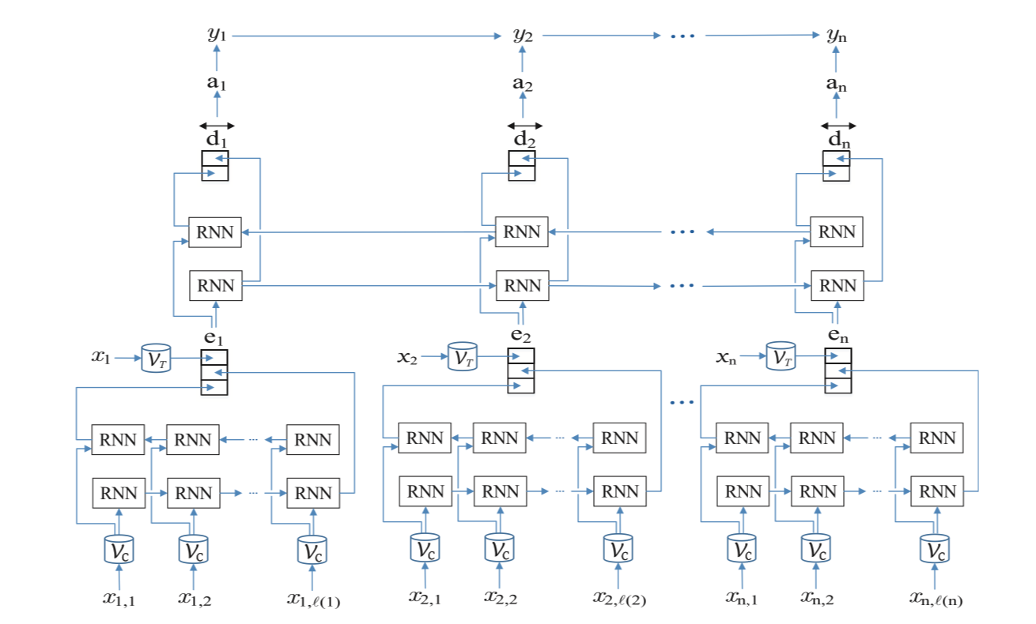
De-identification
Take from: here

Slide 28
Medical Outcome Prediction
prediction based on time series data, for example predicting mortality rate and trajectory of diseases
E.g. Predicting mortality rate, patient’s future condition
Difficulties:
Unstructured data
Lack of labeled data

Slide 29
Summarization
Extractive Summarization
Difficult to deal with diverse types of data (both free text and discrete info) => only train on textual data
Query-based extractive summarization:
summary of sentences relevant to input query. Transformer trained to select the summary sentences
Directly compares query with each candidate. Also use BERT to embed these sentences. Capable to do multi-document summarization as well

Slide 30
Summarization
(2) Abstractive Summarization
More training data is available
Clinical notes:
“Impressions”: labeled abstractive summary
“Findings”: main text
Pointer-generator network architecture mainly

Slide 31
Simplification
EHRs are inaccessible to layperson
E.g. converting “peripheral oedema” => “ankle swelling”
Lexical Substitution
Replace medical jarons with simple phrasings
Identify Complex Words
Select Best Paraphrase

Slide 32
Simplification
(2) Neural Text Simplification
Rewrite entire passage instead of just replacing words
Training corpus: Newsela: (5 level of complexities for paraphrasing the same content)
Wikipedia English and Wikipedia Simple English Articles
Benchmark: System Output Against References and against the Input sentence (SARI). Measuring n-grams against reference simplifications

Slide 33
Simplification
Adjusting the levels of simplification (physician in a different speciality vs layperson)
ACCESS: More fine-grained control such as lexical complexity, length, amount of paraphrasing, syntactic complexities
Unsupervised simplification has been explored as well

Slide 34
Clinical Text Generation
Creating new clinical text from preexisting data
2 purposes:
Reducing clinicians’ burden of writing reports
Useful in generating data for testing models in EHR-NLP: lack of data due to accessibility and confidentiality issues

Slide 35
Clinical Text Generation
Captioning medical images
Synthetic EHR generation through a medical GAN (Choi et al.)
medWGAN and medBGAN as improvements

Slide 36
Phenotyping
More generally, phenotyping refers to the set of characteristics of an organism resulting from its genes and environment. It is a very general concept and refers to any measurable biological markers such as physical appearances, behavior etc.
In EHR, computable phenotype refers to a clinical condition, characteristic that can be determined directly from EHR data and does not involve clinician interpretation
Used to identify patients with a particular condition
Notes:
MORE: https://rethinkingclinicaltrials.org/chapters/conduct/electronic-health-records-based-phenotyping/definitions/

Slide 37
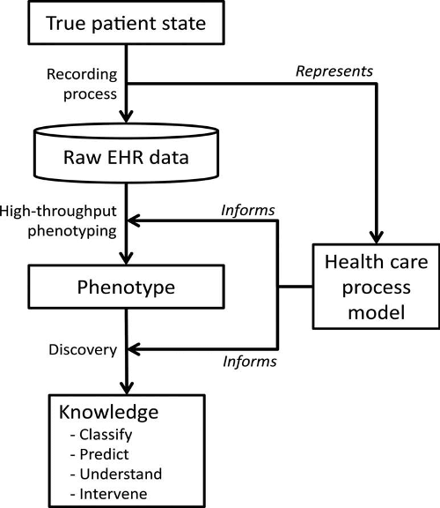
Phenotyping Procedure
Reference: https://rethinkingclinicaltrials.org/chapters/conduct/electronic-health-records-based-phenotyping/definitions/#references
Notes:
Source: Hripcsak and Albers 2013. (Used under a Creative Commons license.)

Slide 38
Phenotyping
Used to obtain more accurate descriptions of illness
Natural clusters of clinical descriptors
Notes:
https://arxiv.org/pdf/1706.03446.pdf

Slide 39
Phenotyping
New phenotype discovery
Definition Improvement
Recent trends: unsupervised learning, difficult due to limited amount of data

Slide 40
PAPERS

Slide 41
PAPER 1 - Prediction: ClinicalBERT
Paper Name: ClinicalBERT: Modeling Clinical Notes and Predicting Hospital Readmission
Author Names: Kexin Huang, Jaan Altosaar, Rajesh Ranganath
Year: 2019

Slide 42
Difficulties
EHR data is unstructured, high-dimensional and sparse, and therefore difficult to apply machine learning models
A lot of clinical notes is needed to make accurate clinical prediction

Slide 43
Scope of ClinicalBERT
This paper develops a discharge support model, clinical BERT to predict patients’ risk of hospital readmission in 30 days
Allows early intervention by physicians
More generally, ClinicalBERT is generalizable to other tasks as well, such as mortality risk estimation

Slide 44
ClinicalBERT
ClinicalBERT learns clinical text deep representation
Deep representations have potentials to be used for clinical insights
ClinicalBERT is a modification of BERT based on the characteristics of BERT

Slide 45
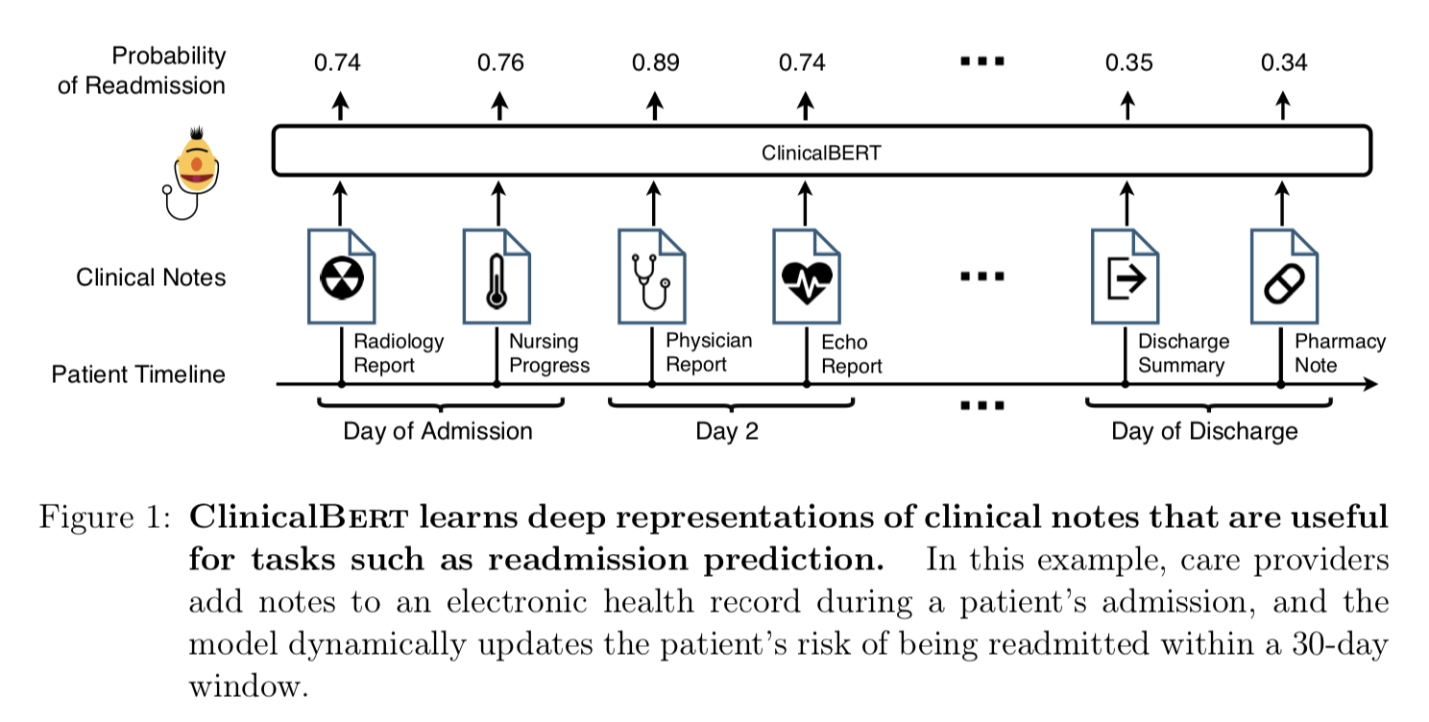
ClinicalBERT

Slide 46
Fine-tuning
BERT: transformer encoder architecture, self-attention, masked language modeling and next sentence prediction, stochastic optimization
NOW: fine-tuning BERT on clinical text
Patient notes converted into tokens then fed to ClinicalBERT
Each token is the sum of (1) position embedding (2) token embedding (3) learned segment embedding

Slide 47
Fine-tuning
Segment embedding identifies which sequence a token is associated with when multiple sequences of tokens are fed to ClinicalBERT
Position embedding is the learned parameters corresponding to the token’s position in the input sequence (and this embedding is shared across token)
Classification token [CLS] is added in front of every sequence of input tokens and later applied in downstream classification tasks

Slide 48
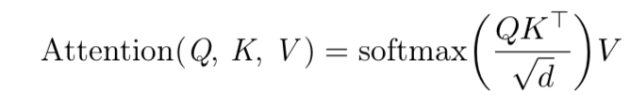
Self-attention
Attention function is computed using embeddings of input tokens.
In the function, an input embedding by multiplied with learned weights is converted into (1) queries , (2) keys, (3) values, where d is the dimensionality of queries, keys and values
Good choice as clinical notes are long and complex, and self-attention can capture the long-range interactions

Slide 49
Pretraining ClinicalBERT
BERT trained on Wikipedia and BooksCorpus
Clinical notes are specific in its jargons and abbreviations etc.
ClinicalBERT pre-trained on clinical notes
Pre-training tasks are the same as Devlin’s:
Masked language modeling masks 15% input tokens
Next sentence prediction: binary prediction if two sentences are in order

Slide 50
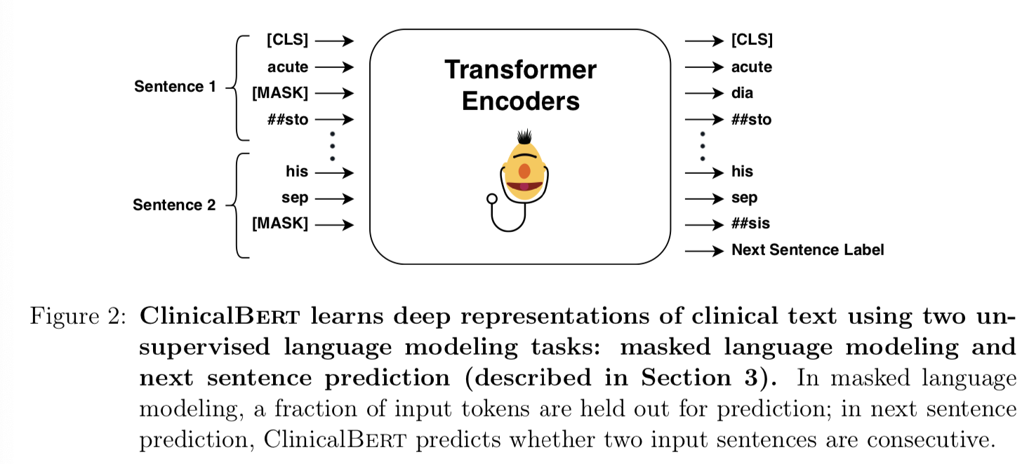
Pretraining

Slide 51
Fine-tuning ClinicalBERT
ClinicalBERT fine-tuned on readmission prediction
Readmit is binary indicator of readmission in next 30 days
Output of clinicalBERT used to predict the probability of readmission
Model fine-tuned to maximize the log-likelihood of the binary classifier

Slide 52
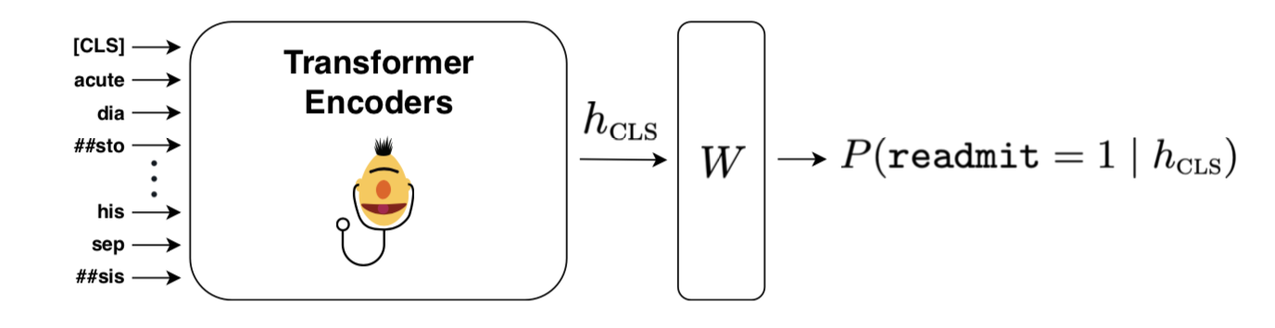
Prediction
Taken from: https://arxiv.org/pdf/1904.05342.pdf
Notes:
W: linear layer applied to the classification representation learned by ClinicalBERT

Slide 53
Test 1: Clinical Word Similarity
Compare with
BERT: outperforms ClinicalBERT in language modeling tasks
Popular word embedding models: in clinical word similarity task, better correlation between concepts learned by ClinicalBERT and human evaluation

Slide 54
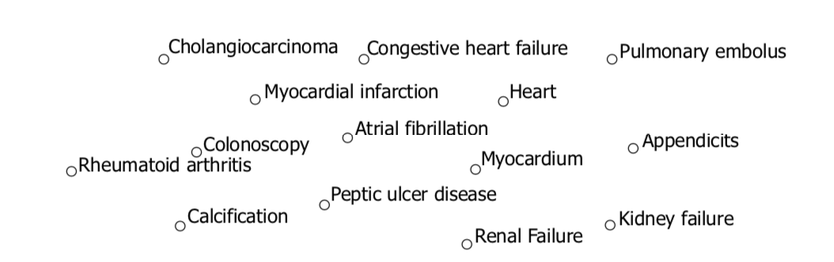
Interpretable Patterns with t-SNE algorithm
Taken From: https://arxiv.org/pdf/1904.05342.pdf
Notes:
ClinicalBert reveals interpretable patterns in medical concepts. The model is trained on clinical notes from mimic-iii, and the embeddings of clinical terms from the dataset in Pedersen et al. (2017) are plotted using the t-distributed stochastic neighbor embedding algorithm for dimensionality reduction (van der Maaten and Hinton, 2008). The full plot is in Section 5; we highlight a subset of the plot centered on a cluster of terms relating to heart conditions such as myocardial infarction, heart failure, and kidney failure.

Slide 55
Training
Basic figures:
Parameters: BERTbase parameters
Model Dimensionality: 768
Adam Optimizer: 2 x 10 ^-5
Maximum sequence length: 512 (first with shorter sequences)
Maximum sequence length of 128 for 75,000 iterations on masked language modeling and next sentence prediction with batch size 32.
Next trained on longer sequences of maximum length 512 for additional 75,000 steps with a batch size of 4.

Slide 56
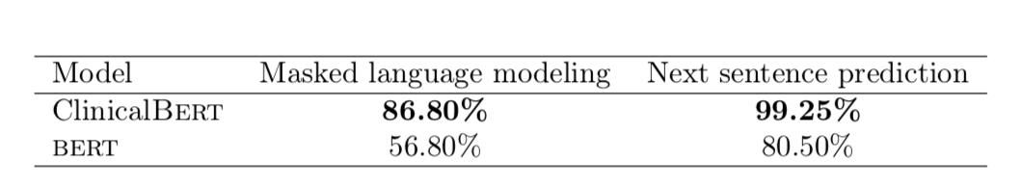
Results: Language Modeling Capability
Evaluated on MIMIC-III data
BERT suffers because of lack of pretraining on Clinical Text

Slide 57
Results: Grouping of terms
Used the concatenation or sum of the last four hidden states of the encoders in BERT to represent medical terms.
Medical terms have different lengths in the dataset, so hidden state for all subwords are averaged.
So we now have a fixed 768-dimensional vector for each medical term, visualized using dimensionality reduction

Slide 58
Visualization

Slide 59
Results: Correlation
30 pairs of medical terms similarity rated by physicians
Compare similarity score with cosine similarity of two concepts embedding
We conclude that ClinicalBERT has a learned representation that groups similar medical concepts

Slide 60
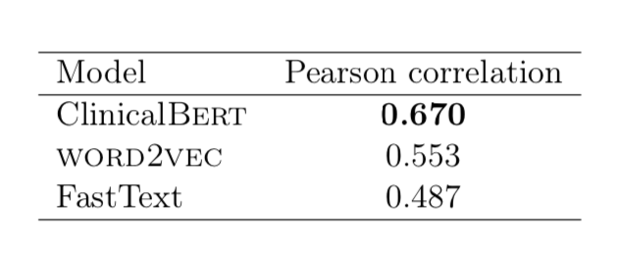
Correlation Comparison

Slide 61
Unsupervised Learning
Learning the graphical structure underlying EHR data to predict heart failure
Not treat EHR as flat-structured bag-of-features
Jointly learning the hidden structure of EHR while performing supervised prediction tasks

Slide 62
Task 2: 30-day Hospital Readmission Prediction
Select patient cohort from MIMIC-III
Patient readmitted within 30 days receive readmit WITHOUT scheduled appointment = 1
Otherwise = 0
Remove deaths from those admissions
Newborns also removed from admissions

Slide 63
Scalable Readmission Prediction
Patients’ notes length are different but ClinicalBERT model has a fixed maximum input sequence length
Splitting notes into subsequences of max length and making predictions on long sequences by binning the predictions on each subsequence

Slide 64
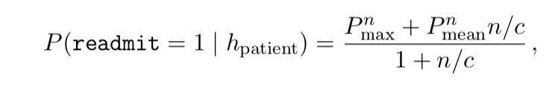
Probability computed using the probabilities outputs of each subsequences:

Slide 65
Further Thoughts
Risk of readmission only using subsequences that correlate with readmission risk => maximum probability over subsequences
Minimize effect of noisy subsequences => average probability of readmission across subsequences
TRADEOFF between MEAN and MAXIMUM in the previous equation
If patient notes is long, noisy maximum probability so scale by c for patients with many clinical notes

Slide 66
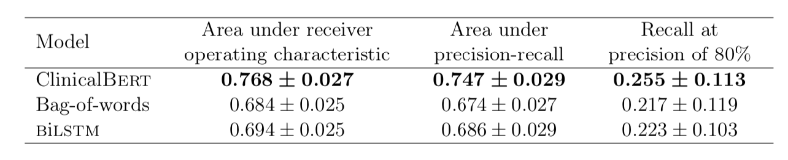
Evaluation
Comparison (data with discharge summaries) with Bag-of-words and BiLSTM shows:

Slide 67
Discharge Summaries
The discharge summary contains essential information of a patient’s stay
Have information like patients’ discharge conditions, procedures, treatments etc.
Have prediction value

Slide 68
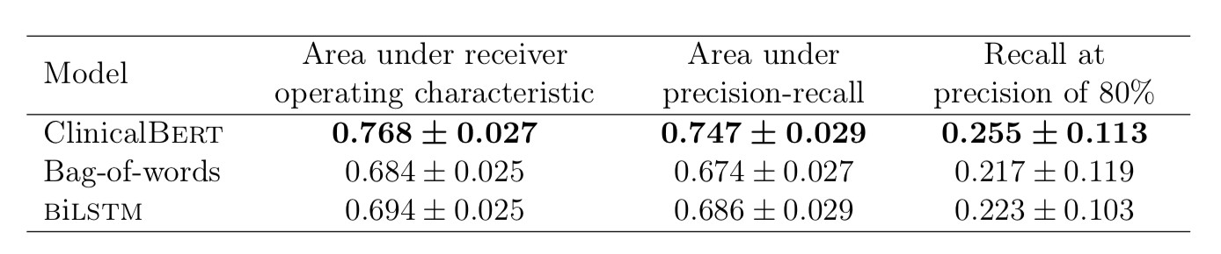
Prediction with Discharge Summaries
Notes:
ClinicalBert accurately predicts 30-day readmission prediction using discharge summaries. The mean of 5-fold cross validation is reported along with the standard deviation. ClinicalBert outperforms both the bag-of-words model and the bilstm deep language model.

Slide 69
Prediction with Early Clinical Notes
Discharge summaries might be written after a patient has left the hospital
Not actionable because doctors cannot intervene after patient is discharged
Models that dynamically predict readmission in early stages are relevant to clinicians
In this set of experiments, only first 48 to 72 hours of patient’s notes are concatenated and used for prediction (filtering out those who left in 72 hours)

Slide 70
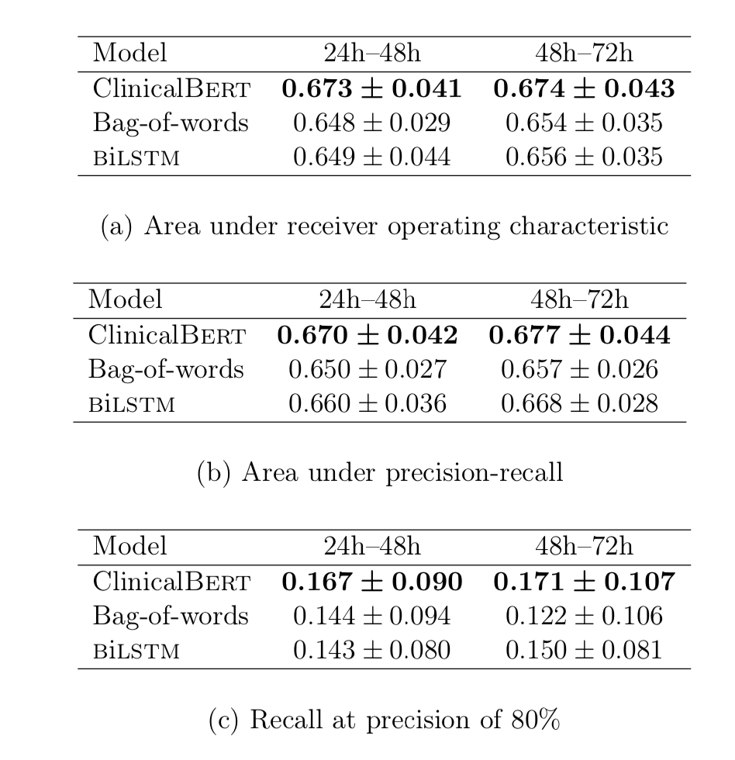
Prediction with Early Clinical Notes
Notes:
ClinicalBert outperforms competitive baselines on readmission predic- tion based on clinical notes from early on within patient admissions. In the mimic-iii data, admission and discharge times are available, but clinical notes do not have timestamps. This is why the table headings show a range; this range shows the cutoff time for notes fed to the model from early on in a patient’s admission. For example, in the 24–48h column, the model may only take as in- put a patient’s notes up to 36h because of that patient’s specific admission time. Metrics are reported as the mean of 5-fold cross validation alongside the standard deviation.

Slide 71
Interpretable predictions in ClinicalBERT
Lack of interpretable predictions makes it difficult for clinicians to trust predictions
ClinicalBERT uses several self-attention mechanism, and can use that to inspect its predictions
High attention weight between query and key means interaction between tokens is predictive of readmission
Each self-attention mechanism specializes to different patterns indicative of readmission
Notes:
ClinicalBERT encoder consists of 144 self-attention mechanisms, 12 multi-head attention mechanisms for each of the 12 transformer encoders

Slide 72
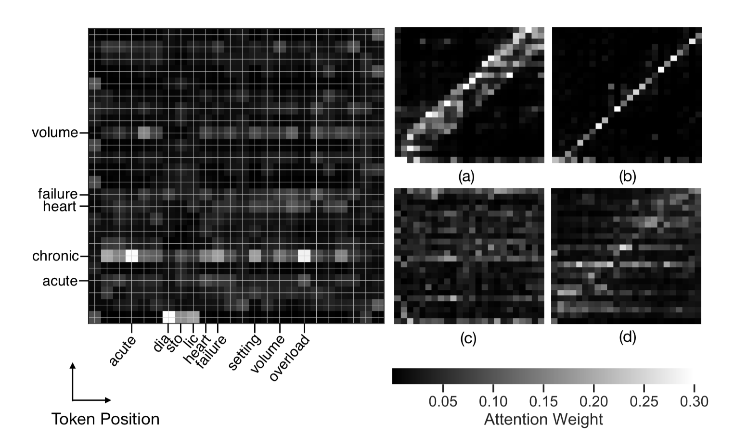
Visualization
“Chronic”, “acute”
Notes:
ClinicalBert provides interpretable predictions, by revealing which terms in clinical notes are predictive of patient readmission. The self- attention mechanisms in ClinicalBert can be used to interpret model predictions on clinical notes. The input sentence “he has experienced acute chronic diastolic heart failure in the setting of volume overload due to his sepsis.” is fed to the model (this sentence is representative of a clinical note found in mimic-iii). Equation (4) is used to compute a distribution over tokens in this sentence, where every query token is itself a token in the same input sentence. In the left panel, we show one of the self-attention mechanisms in ClinicalBert, and only label terms that have high attention weight. The x-axis are the query tokens and the y-axis are key tokens. Panels (a), (b), (c), and (d) show other self-attention mechanisms in the model with the same input sentence, showing that they have specialized to various patterns in clinical notes indicative of readmission.

Slide 73
Attention Mechanism
In the previous slides, attention weights are high for keys within a certain window of query token
This Attention Mechanism high for keys within a certain window of a query token
Focuses on local information analogously to local context window used in word2vec

Slide 74
PAPER 2: COVID-19 Literature Knowledge Graph
Paper: COVID-19 Literature Knowledge Graph Construction and Drug Repurposing Report Generation
Author names: Qingyun Wang, Manling Li, Xuan Wang, Nikolaus Parulian, Guangxing Han, Jiawei Ma, Jingxuan Tu, Ying Lin, Haoran Zhang, Weili Liu, Aabhas Chauhan, Yingjun Guan, Bangzheng Li, Ruisong Li, Xiangchen Song, Heng Ji, Jiawer Han, Shih-Fu Chang, James Pustejovsky, Jasmine Rah, David Liem, Ahmed Elsayed, Martha Palmer, Clare Voss, Cynthia Schneider, Boyan Onyshkevych
Year: 2020

Slide 75
Overview
New knowledge discovery framework: COVID-KG
Extraction of more fine-grained multimedia knowledge elements from scientific literature
Multimedia knowledge graph:
Used for (1) Question answering
(2) Report generation

Slide 76
Challenges
Professionals digesting paper:
Rapid growth in relevant literature
Quality of publications not guaranteed. Need a more reliable collection of papers

Slide 77
COVID-KG
Multimedia knowledge graphs:
Nodes: entities/ concepts
Edges: relations/ events to link entities
KG with path ranking and evidence mining to answer questions

Slide 78
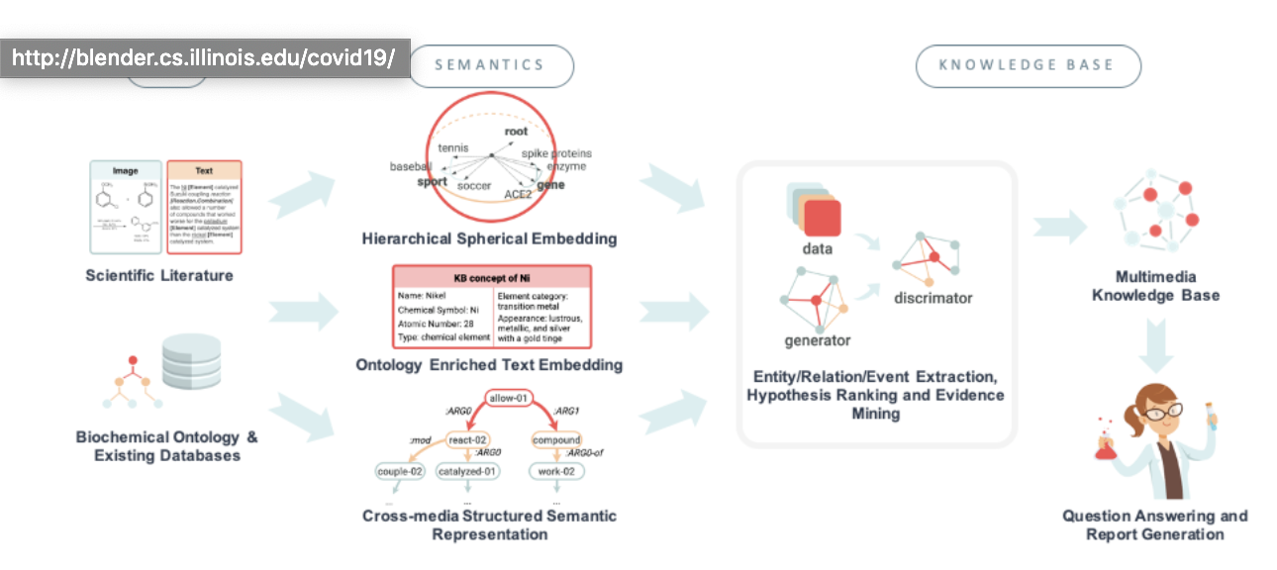
Data to Semantics to Knowledge

Slide 79
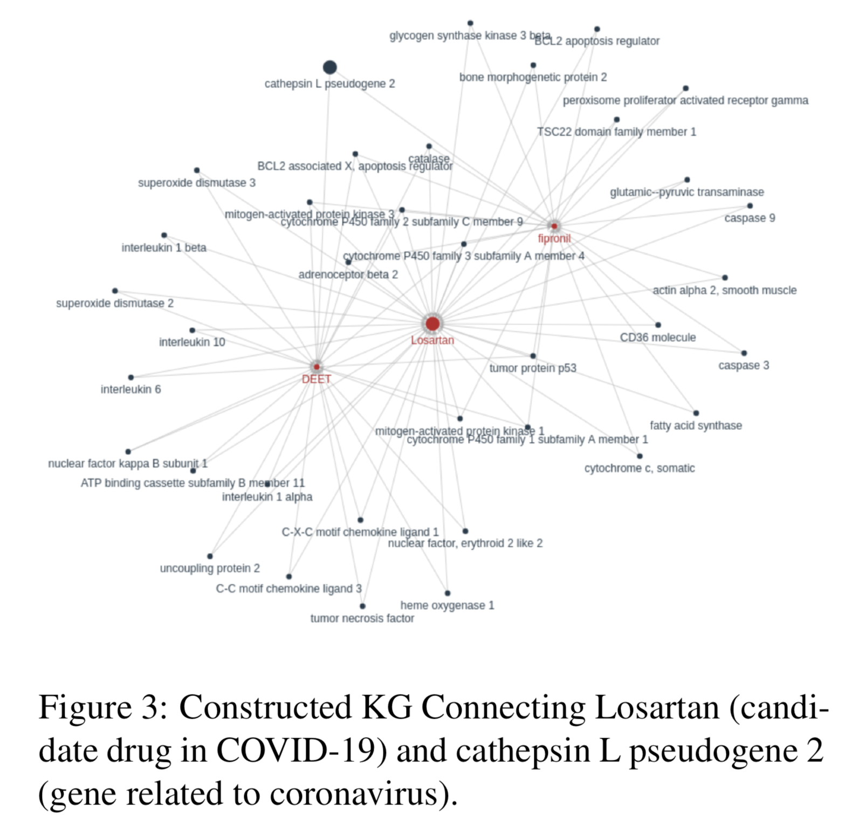
Knowledge Graph

Slide 80
Coarse-grained Text Knowledge Extraction
Coarse-grained entity extraction and entity linking:
Gene nodes, disease nodes, chemical nodes, organism
For each mention, obtain a medical subject headings unique ID

Slide 81
2. Link all entities to CTD and extract 133 subtypes of relations

Slide 82
3. Event extraction
Extract 13 event types and roles of entities
Notes:
Expand on papers cited

Slide 83
Fine-grained Text Entity Extraction
Expert questions contain words that are fine-grained knowledge elements
E.g. “Which amino acids …?”
Apply the fine-grained entity extraction system CORD-NER to extract 75 types of entities to enrich the KG
CORD-NER needs no intensive human annotation
Has better annotation quality than Scispacy (another fully supervised BioNERT tool)

Slide 84
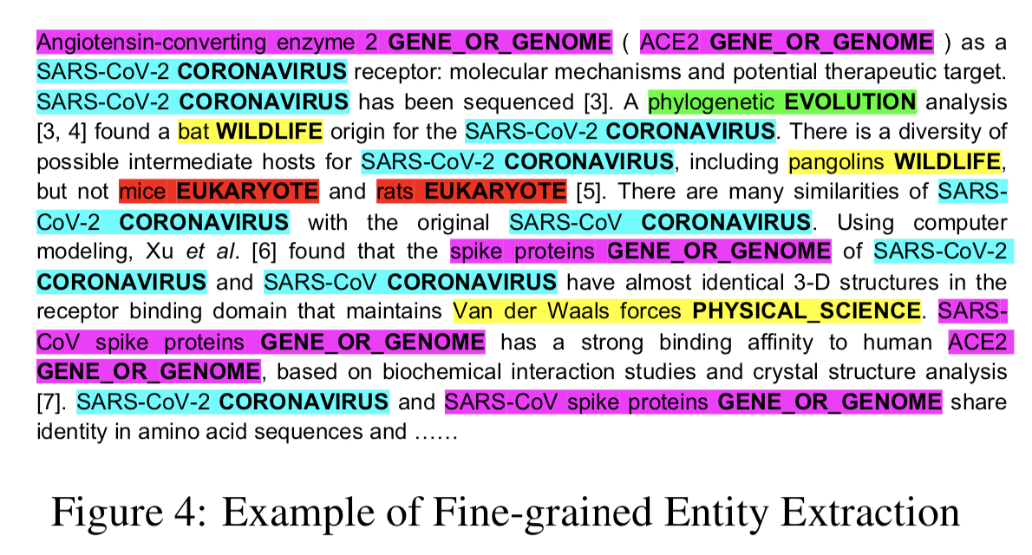
Fine-grained Entity Extraction

Slide 85
Image Processing and Cross-media Entity Grounding
Rich visual-only information like molecular structures, curves and relational diagrams in biomedical papers
1)Extract figures from papers and segment figures to close to half a million subfigures
2)Perform cross-model entity grounding to ground entities mentioned in captions

Slide 86
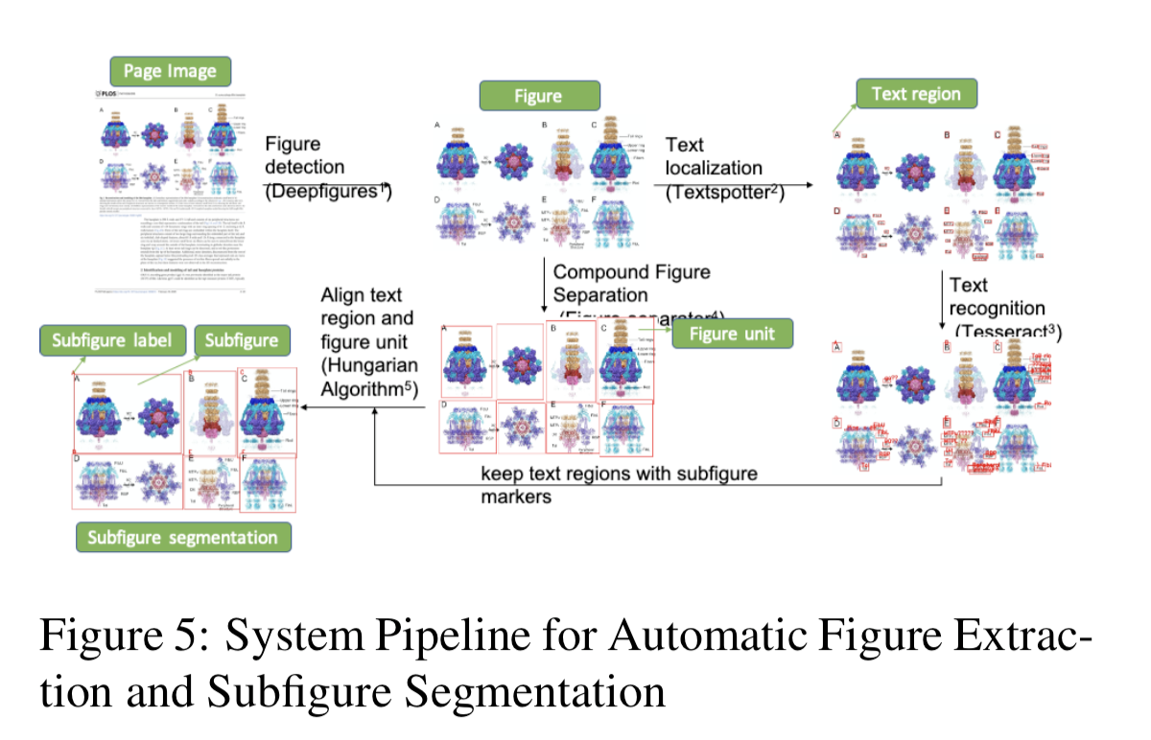
Extracting Image

Slide 87
Extracting Images
Use Deep-figures (Siguel et al., 2018) to detect and extract figures from each PDF
Each figure corresponds to text in caption, or the main text that is referring to
This gives a way to attach a figure to an KG entity for the KG entity of that text

Slide 88
Pipeline to segment individual subfigures, and then put each subfigure with its subcaption
FIgure-separator is used to detect and separate all non-overlapping image regions
Subfigures in a figure are marked with alphabetical letters, which we then use deep neural networks to detect text in the figures and use OCT tools to recognize text information within each figure

Slide 89
Use local proximity to distinguish subfigure marker text from text labels
Location information of each text marker used to merge multiple image regions into a single subfigure
Each subfigure is segmented and associated text labels provide information to expand the knowledge graph constructed just purely from caption

Slide 90
Knowledge Graph Semantic Visualization
Create semantic visualization over large complex networks of biomedical relations
Semantic realization visualizes subsets of relations relatively through semantically typed tag and heat maps
Global not just a single word
Easily identify new relationships missed

Slide 91
Example
Data index from knowledge element => Kibana dashboard
E.g. clicking the protein keyword EIF2AK3 in the tag cloud called “Enzyme proteins participating Modification relations” and the visualization is changed

Slide 92
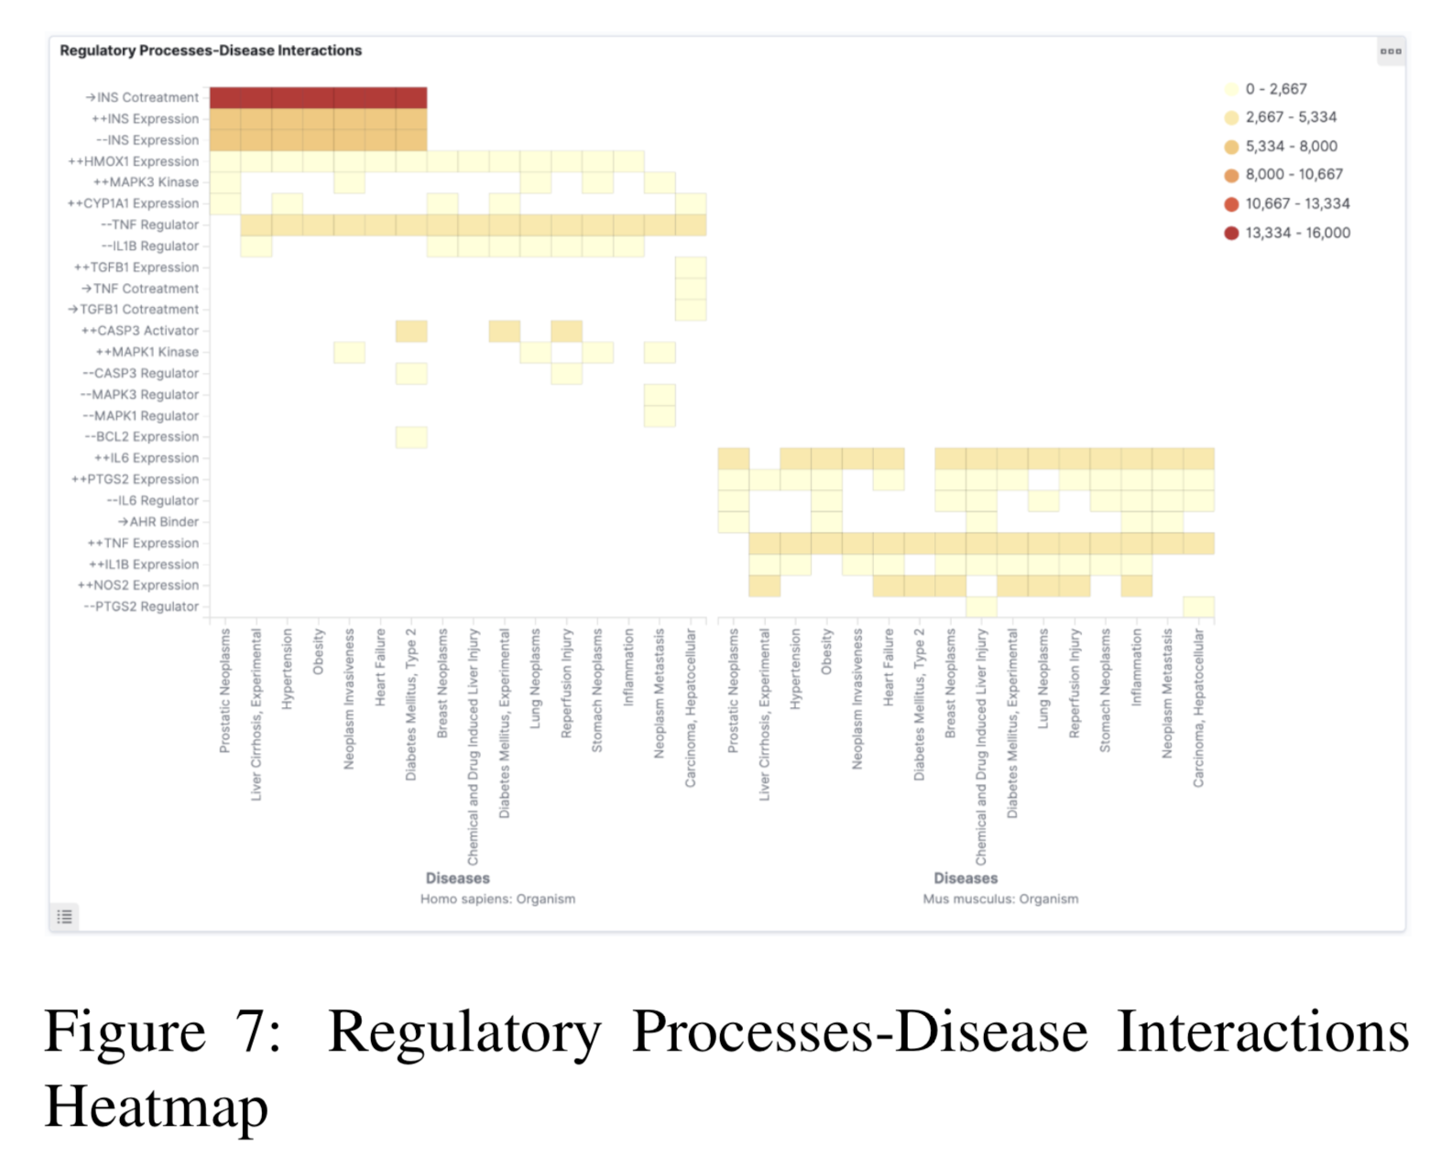
Heatmap
SemViz Semantic Visualization has dense tag clouds (visualization of relation) and dense heatmaps (multiple chained relations) hrough process of parameter reduction over relation
Notes:
Figure 7 illus- trates such a dense heatmap, where a functionally typed protein is implicated in a disease relation (e.g., “those proteins that are down-regulators of INF which are implicated in obesity”).

Slide 93
Knowledge-driven Question Answering
QA component based on combining knowledge graph matching and distributional semantic matching (instead of just single document)
Build knowledge graph indexing and searching functions to allow efficient search

Slide 94
Common Question: Connections between 2 entities. Generate a subgraph that covers the path between them
Paths generated by traversing the KG and these paths are ranked by frequency of the paths
Each edge has a score equal to the sum of score of paths passing through the edge

Slide 95
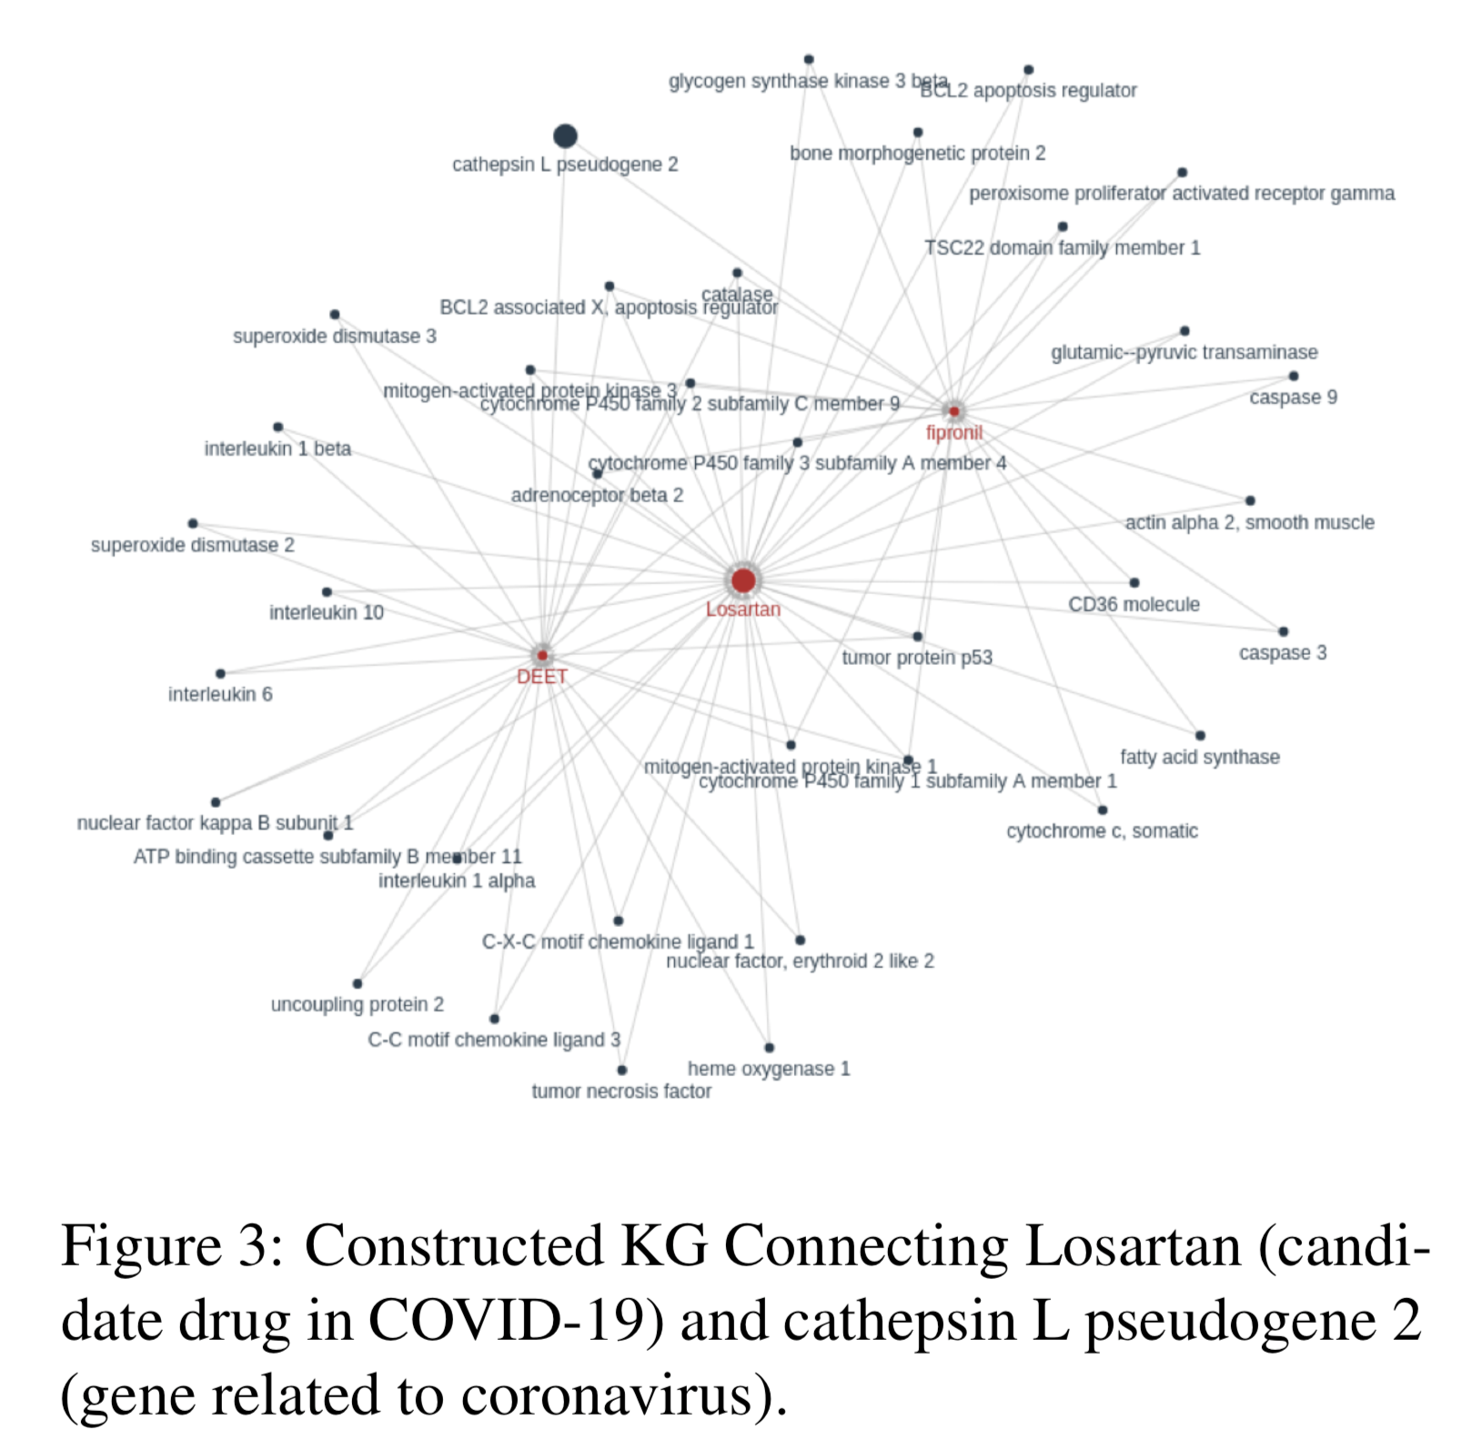
Knowledge Graph

Slide 96
BioBERT is used to represent each sentence with left and right neighboring sentences as local contexts
Aggregate the sentence embedding layer with average pooling
Use similarity between embedding representation of each sentence and query to extract the most relevant sentences as evidence

Slide 97
Queries often provide entity types instead of entity instances that requires us to extract evidence sentences based on a pattern
The paper developed EVIDENCEMINER, web-based system to allow user query as natural language statement and automatically retrieves textual evidence from COVID-19 corpora

Slide 98
Case Study: Drug Repurposing Report Generation
Human written report about drug repurposing contains
Current indication
Molecular Structure
Action Mechanism
Drug identified by manual or computation screen
Who is studying the drug
...

Slide 99
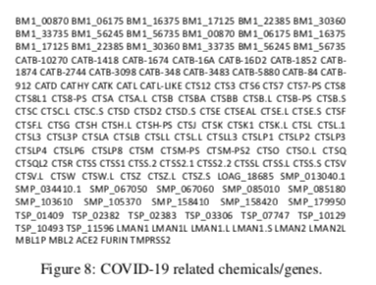
DARPA biologist suggests three drugs: Benazepril, Losartan, Amodiaquine

Slide 100
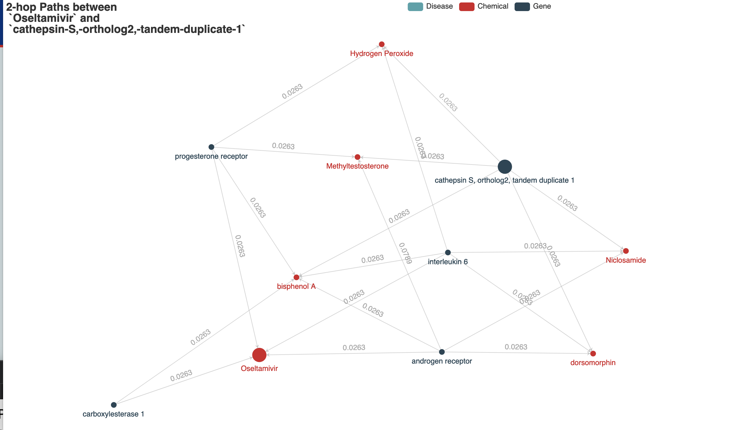
Visualization
http://blender.cs.illinois.edu/ covid19/visualization.html

Slide 101
Results
Human Evaluation find them to be Informative, valid and sound
E.g. coronavirus enters the cell in the lungs, can cause a severe disease call Acute Respiratory Distress Syndrome - release of molecules named cytokines

Slide 102
Implications
Transforms a massive scientific literature corpus into organized, structured and actionable knowledge graphs
Obtain trustworthy and non-trivial answer and spend more time on testing the hypothesis suggested
Expand COVID-KG to automate creation of new hypotheses
Incorporating multimedia in site

Slide 103
Paper #3 Automatic Generation of Imaging Reports
Paper Name: On the Automatic Generation of Medical Imaging Reports
Author Names: Baoyu Jing, Pengtao Xie, Eric P. Xing
Year: 2018

Slide 104
Needs
Need arises from:
Error-prone for unexperienced physicians
Time-consuming for experienced ones
=> Automatic generation of medical imaging reports

Slide 105
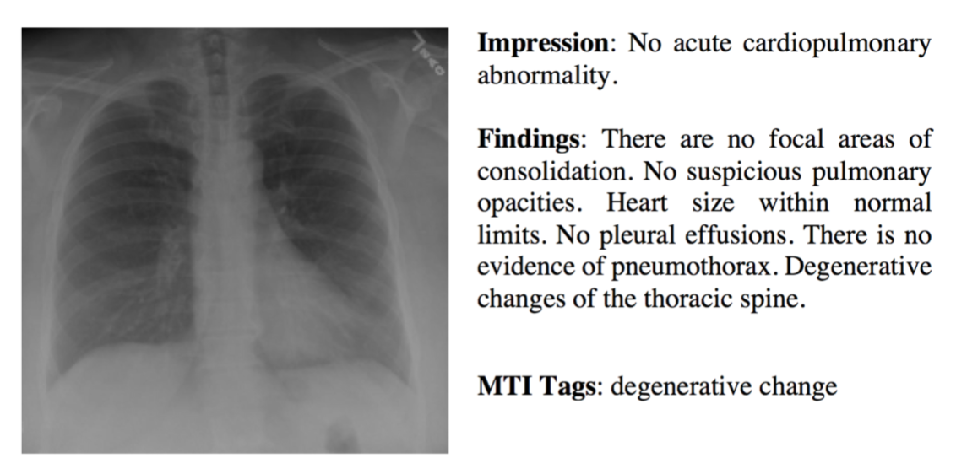
Difficulties
Heterogeneous forms of information within one single diagnostic report (sentence, paragraph, keywords)

Slide 106
Approaches
Demanding to generate all the text above in a unified framework
So use multitask framework:
Tags: multi-label classification
Long descriptions: text generation

Slide 107
Difficulties
Abnormal regions difficult to identify
=> co-attention mechanism, simultaneously attending to images and predicted tags and explores the synergistic effects of visual and semantic information

Slide 108
Difficulties
Descriptions are long and have multiple sentences
=> hierarchical LSTM than single LSTM
=> first generate high-level topics then produces fine-grained descriptions according to the topics

Slide 109
Related Work
Previous works show semi-structured or fully-structured texts, but not natural texts
This paper focuses on natural reports written by physicians rather than semi-structured texts
Previous work did not make use of Co-attention mechanism, but only attention mechanism

Slide 110
CNN to learn visual features => multi-label classification (MLC) network to predict the relevant tags
Each tag represented by word-embedding vector
Word-embedding vectors serve as semantic features of the image
Visual features and semantic features fed into co-attention model to generate a context vector

Slide 111
Decoding
Decoding generates text descriptions
First generates a sequence of high-level topic vectors representing sentences, then a sentence from each topic vector.
Specifically, the context vector fed into sentence LSTM and produces a topic vector at each step, which covers the semantics of a sentence to be generated
Word LSTM takes in topic vector and generates a sequence of words.
Termination controlled by sentence LSTM

Slide 112
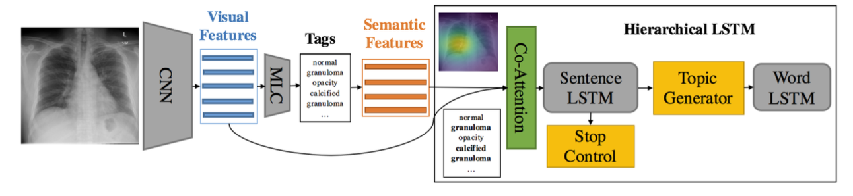

Slide 113
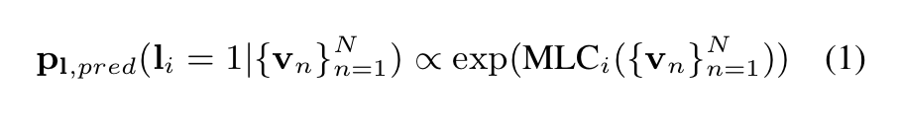
Tag Prediction
Task 1: predict tags of an image
Tag prediction as a multi-label classification task
Extract features of an image from intermediate layer of a CNN
Then feed into a multi-label classification network to generate distribution over all L tags
Notes:
Simplification: last 2 fully connected layers of VGG-19 and extract visual features from the last convolutional layer of VGG-19 model. Embeddings of M most likely tags used as semantic features for topic generation

Slide 114
Co-attention
Visualization attention performs well but insufficient for high level semantic information
(e.g. only focusing on lower region but ignoring other areas increase difficulties of recognition)
Tags can always provide the needed high level information -> coattention that attend to both visual and semantic

Slide 115
Co-attention
Joint context vector generated by coattention network
Coattention network uses a single layer feedforward network to compute soft visual and semantic attentions over input image and tags
We concatenate visual and semantic context vectors then use a fully connected layer to obtain a joint context vector

Slide 116
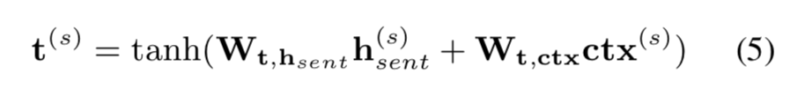
Sentence LSTM
Single layer: It takes joint context vector as its input and generates topic vector for word LSTM through topic generator and determines stop or continue generating captions
Topic Generator: context information in topic vector by combining hidden state and joint context vector

Slide 117
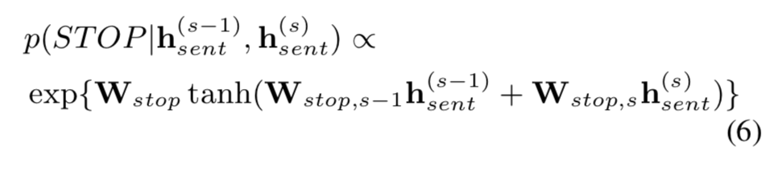
Sentence LSTM
Stop control: deep output layer to decide if LSTM continues. The layer takes previous and hidden state and produces a distribution over {0, 1}
If p over a set threshold, LSTM stops producing topic vector and word LSTM stops producing words

Slide 118
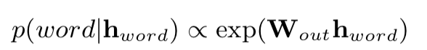
Word LSTM
Words of each sentence generated by a word LSTM
Topic vector produced by LSTM and the special START token used as the first and second input of the word LSTM, and append the word sequence
Hidden state of word LSTM used to predict distribution over words
Concatenation of all generated sequences is the final report

Slide 119
Parameter Learning - Stage 1
Training example treated as a tuple: (I, L, w)
I: image
L: ground-truth tag vector
W: diagnostic paragraph (with S sentences, and each sentence consists of T_s words)
Model performs multi-label classification on I and produces a distribution over all tags

Slide 120
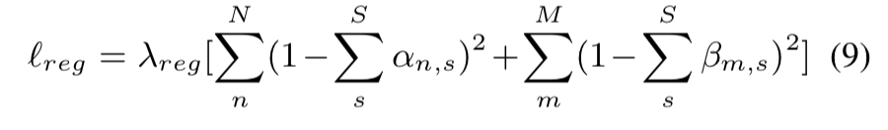
Parameter Learning - Stage 2
Sentence LSTM unrolled for S steps to produce topic vectors and distributions over {STOP, CONTINUE}
S topic vectors fed into word LSTM to generate words
Training loss consists of two cross-entropy losses: over stop distributions and over word distributions
Regularization term for visual and semantic attentions

Slide 121
Multi-label classification on I and produces a distribution p over all tags
L: binary vector that encodes the presence and absence of tags
Ground-truth tag distribution by normalizing

Slide 122
LSTM unrolled for S steps to produce topic vectors and distributions over {STOP, CONTINUE}
Topic vectors put into word LSTM to generate words ws, t
Training loss of caption generation is the combination of two cross-entropy losses
Regularization term for visual semantic attentions

Slide 123
Experiments
Datasets:
IU X-Rays
Indiana University Chest X-Ray Collection: set of chest x-rays paired with corresponding diagnostic reports (7470 pairs)
PEIR Gross: 7,442 image-caption pairs
Pathology Education Information Resource digital Library: public medical image library for medical education

Slide 124
Implementation
Tag prediction: VGG-19 model
MLC task: multilabel retrieval task
Paragraph generation: dimensions of all hidden states and word embeddings as 512

Slide 125
Metrics
BLEU
METEOR
ROUGE
CIDER

Slide 126
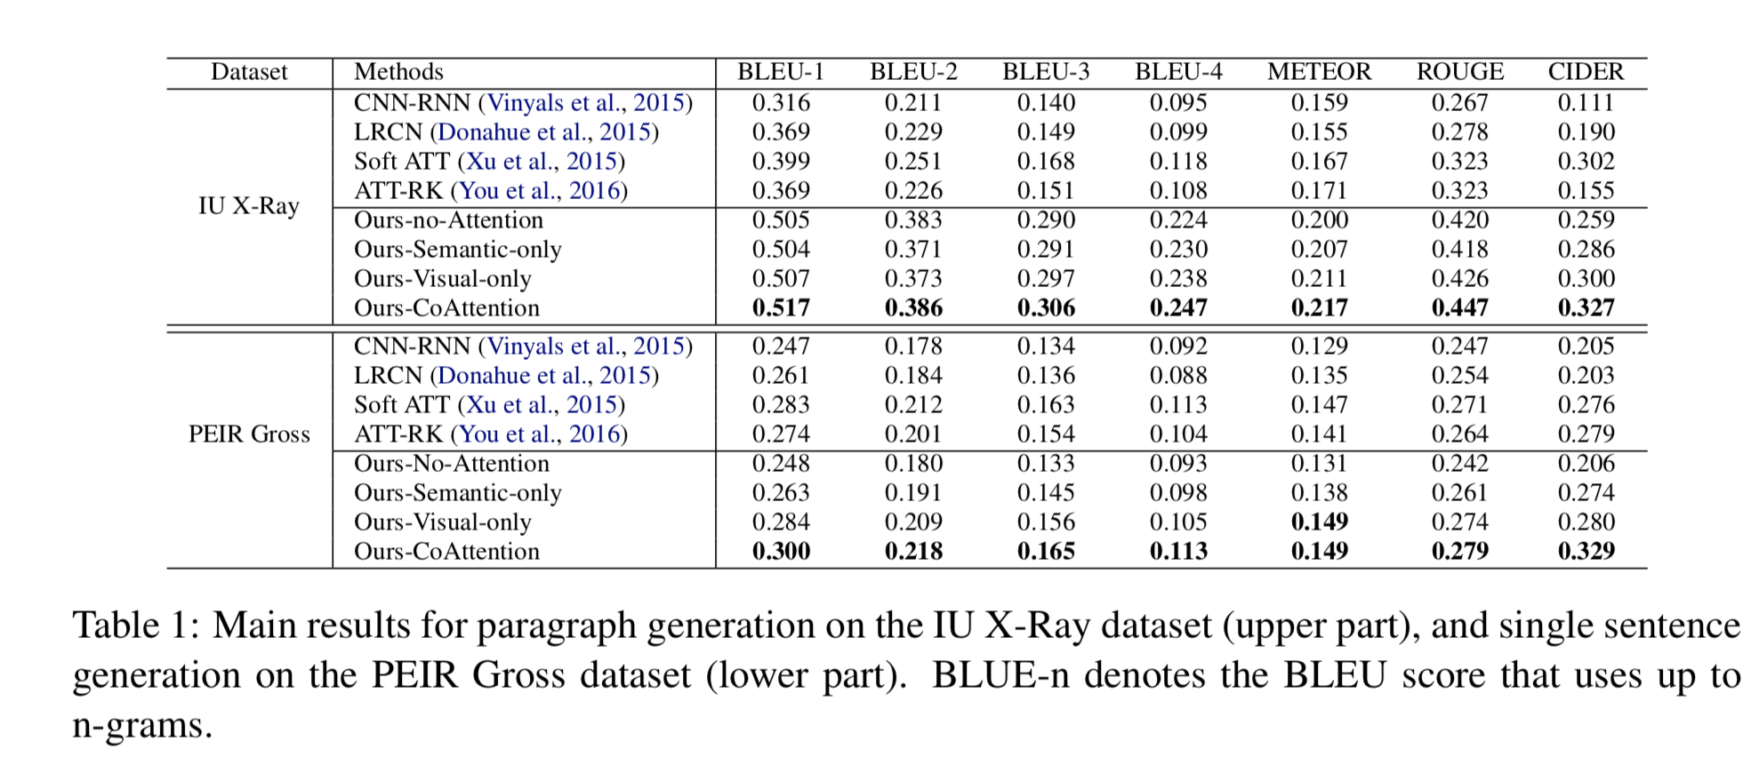
Results

Slide 127
Paragraph Generation
First sentence: general description of image. Each image is associated with one area of image
Ours-CoAttention able to correctly describe many true abnormalities
Third Sentence: detects the area

Slide 128
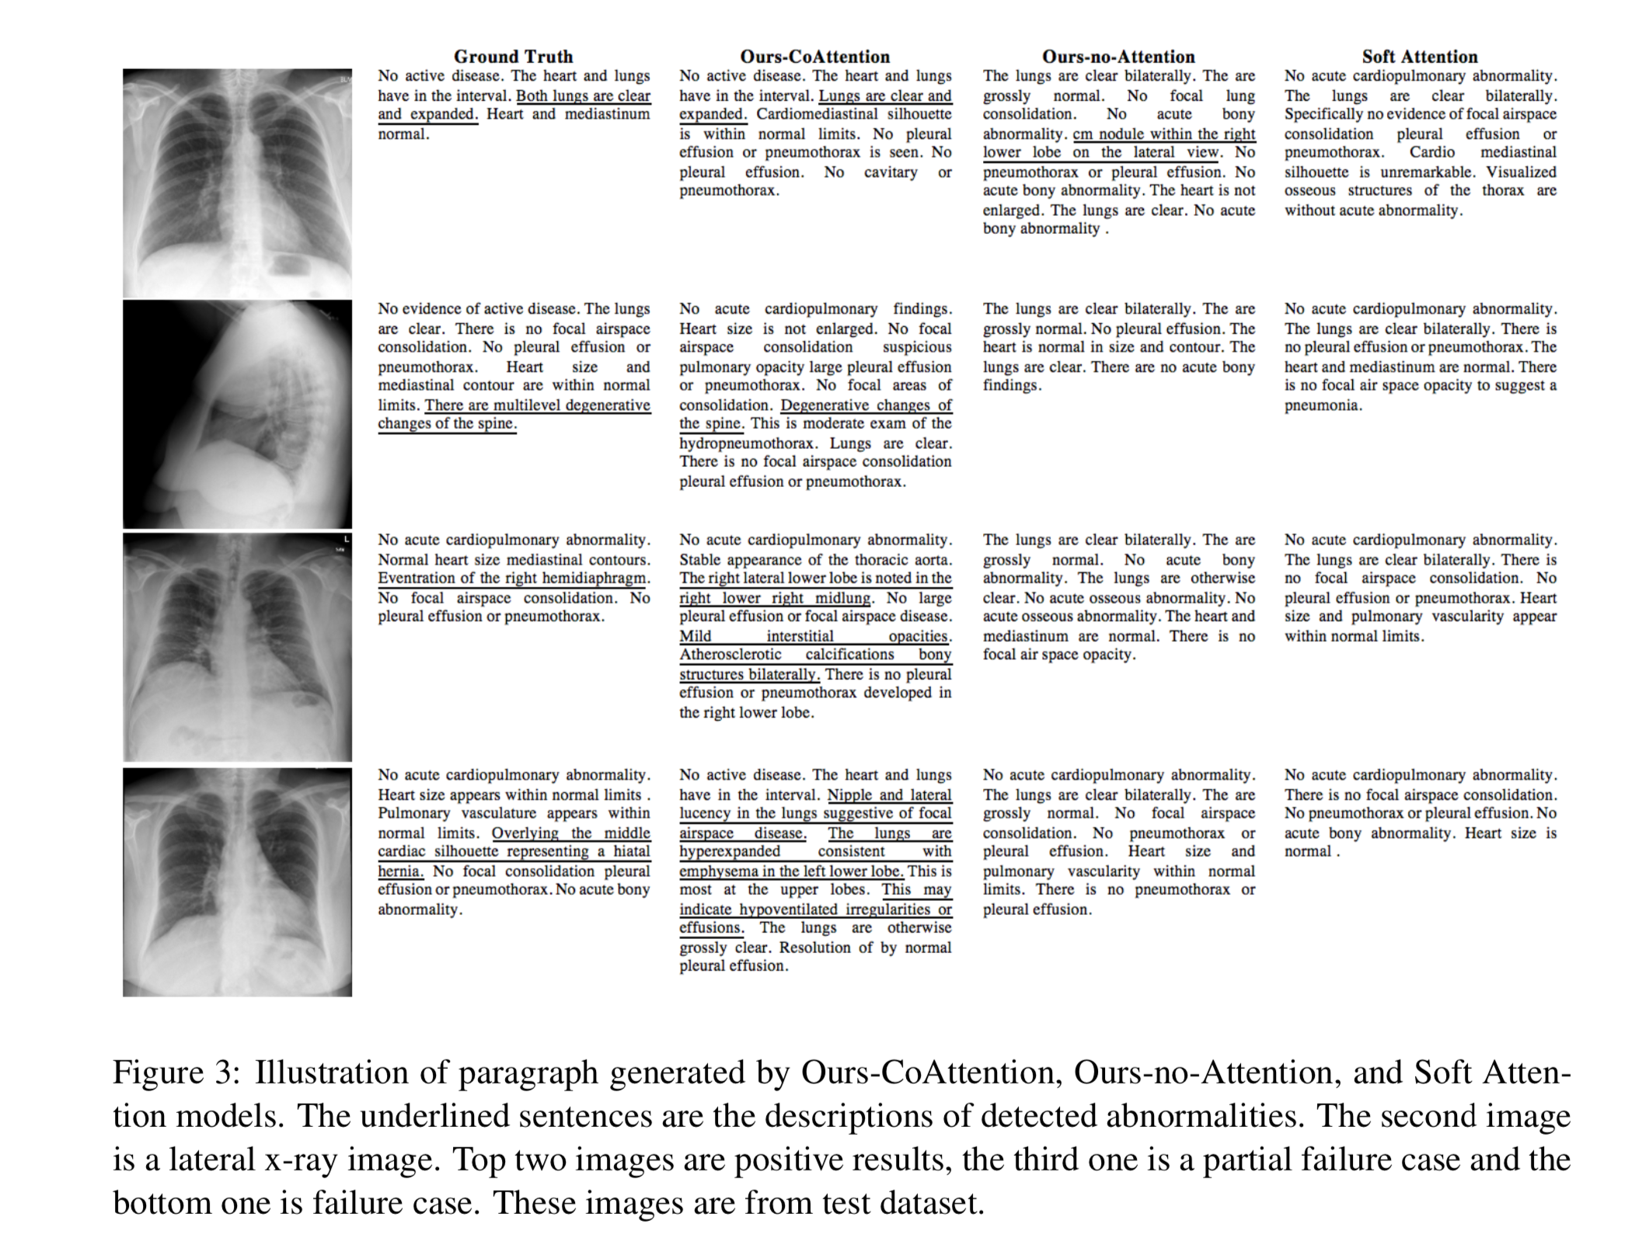

Slide 129
Co-Attention Learning
Visualizations of co-attention shows that: (1) LSTM can generate different topics at different time steps
(2) can guide our model to concentrate on relevant regions of the image
(3) first sentence is a mis-description by incorrect semantic attention

Slide 130
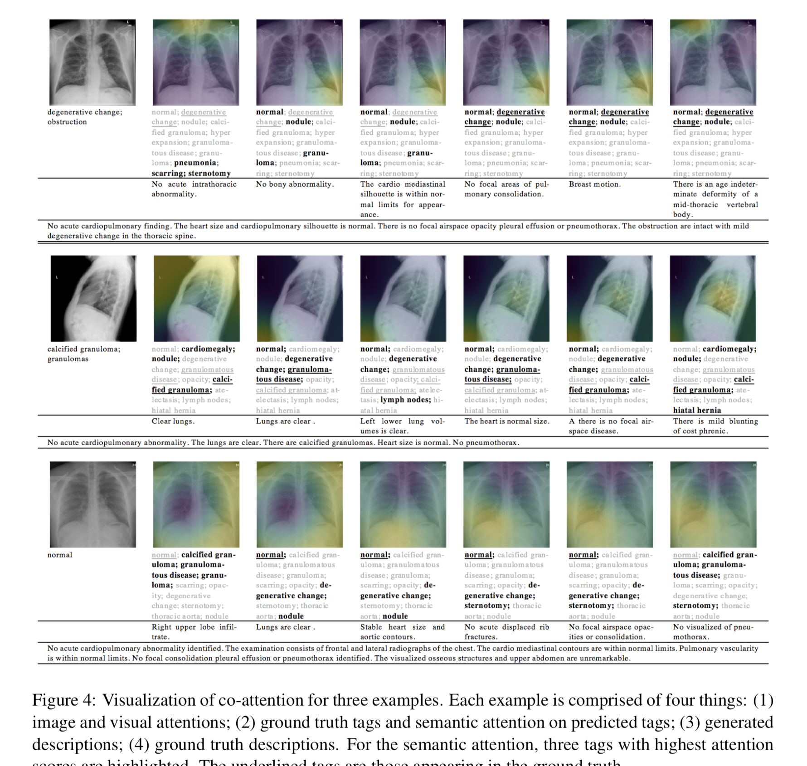

Slide 131
Recap
Automatically generate textual reports for medical images
Problems addressed by the paper:
Generate varied forms of information while staying in a unified framework
Locate abnormal regions and write descriptions
Generate long texts that have multiple sentences or paragraphs

Slide 132
PAPER #4 MEDTYPE
Paper Name: MEDTYPE: Improving Medical Entity Linking with Semantic Type Prediction
Author Names: Shikhar Vashishth, Rishabh Joshi, Denis Newman-Griffis, Ritnam Dutt, Carolyn Rose
Year: 2020

Slide 133
Overview
Identifying standardized concept
Medical Entity Linking (medical concept normalization): harmonizing different surface forms for the same concepts

Slide 134
Subproblems
Named Entity Recognition
Candidate Generation
Word/ phrase sense disambiguation

Slide 135
Candidate Generation
Previous approaches: dictionary lookup and string matching
Overgeneration of candidates are key to leveraging the high coverage by neural approaches

Slide 136
MEDTYPE
Pruning out overgenerated candidates in medical entity linking by predicting the semantic type of an entity mention
Address the dearth of annotated training data for medical entity linking: WIKIMED, PUBMEDDS
Type-based filtering reduces number of candidates for WSG

Slide 137
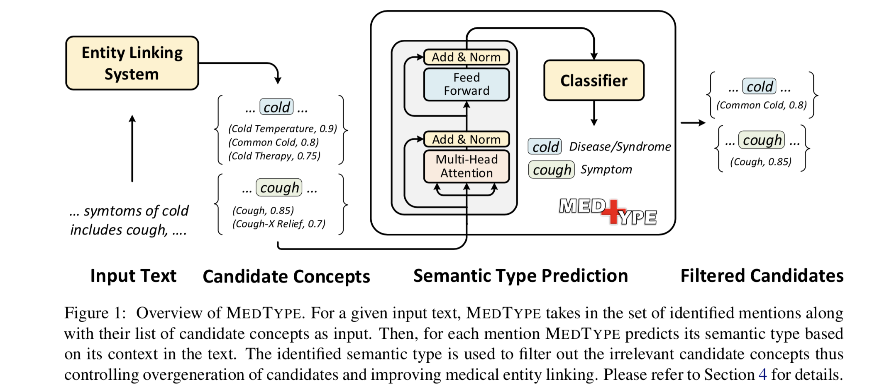
MEDTYPE

Slide 138
MEDTYPE
Inability to resolve ambiguity among possible concepts for a given mention
Problems: polysemy, homonymy lead to overgeneration of candidate concepts

Slide 139
MEDTYPE: filters generated candidates for a mention based on predicted semantic type
Medtype is neural when encoding context to predict the semantic type, while previous ones are not
Proposing WIKIMED and PUBMEDDS: two large annotated medical linking dataset

Slide 140
MEDTYPE DETAILS
Previous work:
Set of entities given by UMLS (Unified Medical Language System), large collection of multiple source vocabularies that provides coverage of 4 million biomedical concepts
NER: recognizing concepts from text
Candidate Generation: generate candidates based on identified mention
WSH: assigning a score to each candidate concept

Slide 141
To avoid overgeneration, MedType is introduced: outputs a filtered set from a generated candidate set C by predicting the semantic type of the mention
UMLS maps concepts to one of the 127 semantic types (examples: “disease or synchrome”, “anatomical structure”)
Medtype models entity typing then as multi-label classification problem, and uses the predicted types of mention to cut down data concept set

Slide 142
Context Encoder
Input data consists of ordered pairs (x, y):
X: mention along with its context (neighboring tokens in size of k window)
Con(m, k) and y is the semantic type
Again uses BERT to capture long-range dependencies
Use pre-trained BERT encoder and fine-tune for this specific prediction task
Feeding in the mention concatenated with its context as input to the encoder with positional information
Embedding corresponding to CLS token passed to feed-forward classifier

Slide 143
Creation of Corpus
Data and privacy issues
Crowd-sourced annotation is expensive
SOLUTION: automatically create two large training datasets for medical entity linking

Slide 144
Transfer Learning with WikiMed
The paper introduced a wikipedia-based dataset for medical entity linking
Wikipedia contains many mentions of medical concepts that might be useful
Three knowledge sources to map hyperlinks in Wikipedia to UMLS: Wikidata, Freebase, NCBI Taxonomy
Wikipedia is human curated so can assume high accuracy of mappings
Wikimed as one of the evaluation datasets for accessing the performance of entity linking on non-medical context

Slide 145
PubMedDS
Distant Supervision allows automatic generation of training data
Use distant supervision on PubMed abstracts to generate PubMedDs, which is used in as training dataset for medical entity linking

Slide 146
Experiments
Model evaluated on:
NCBI
Bio CDR
ShARe
MedMentions
WikiMed
(evaluation on PubMedDS avoided because some mentions might be wrongly annotated)

Slide 147
Wide range of domain including biomedical research articles, EHR and general domain text

Slide 148
Medical Entity Linkers
Use MedType to prune candidate concepts generated from the following entity linking models:
MetaMap
cTAKES
MetaMapLite
ScispaCy

Slide 149
Evaluation Metrics
F-1 score on
Exact mention id match (Both mention and entity concept identifier map)
Partial mention id match (partial score for mention and entity id match)
Only entity id match (only entity identifers)

Slide 150
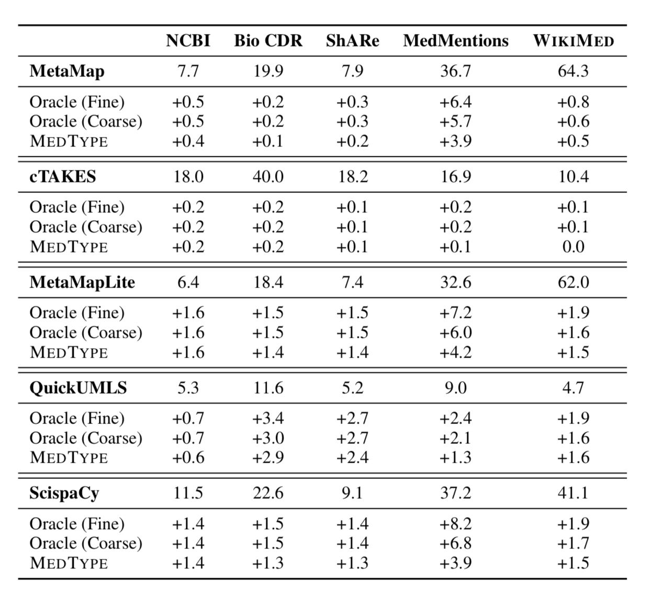
RESULTS: Entity Linking with MedType
Compare its performance with other entity linkers

Slide 151
Impact of Semantic Type Prediction
Semantic type-based pruning consistently reduces the candidate set size
Medtype helps improve the full extraction pipelines

Slide 152
PAPER #5: LEARNING GRAPHICAL STRUCTURE
Paper Name: Learning the Graphical Structure of Electronic Health Records with Graph Convolutional Transformer
Author Names: Edward Choi, Zhen Xu, Yujia Li, Michael W. Dusenberry, Gerardo Flores, Emily Xue, Andrew M. Dai
Year: 2020

Slide 153
Important
Learning Effective representations of EHR features are important
Each encounter as an unordered set of features or bag of features
Ignorant of physician’s actual decision process

Slide 154
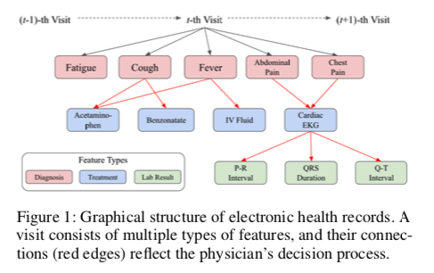
Example

Slide 155
Unsupervised Learning
Learning the graphical structure underlying EHR data to predict heart failure
Not treat EHR as flat-structured bag-of-features
Jointly learning the hidden structure of EHR while performing supervised prediction tasks

Slide 156
Previous Works
MiME: reflects EHR’s encounter structure (paying attention to diagnosis and treatment)
Outperforming various bag of features

Slide 157
Structure Information of EHR
How about no structure information for EHR? Often, EHR has incomplete structure information
Omission: claims data have no structure information
Describe treatment lead to measuring certain lab values but not describe the reason diagnosis for ordering the treatment

Slide 158
Graph Convolutional Transformer (GCT)
New approach to jointly learn hidden encounter structure while performing various prediction tasks while structure information is not available
Significance:
Successful perform the jointly learning of hidden structure of EHR data and supervised prediction task
Novel modification to the Transformer to guide self-attention to learn EHR using prior knowledge by attention masks and prior conditional probability probability based regularization
Outperforms baseline models in prediction task for various datasets

Slide 159
Electronic Health Records as Graph
T-th visit V with visit node on top.
Diagnosis nodes d
Treatments m
Produce lab results which may be associated with continuous values or binary values

Slide 160
Encounter: graph consisting nodes with an adjacency matrix A that describes the connections between the nodes
Given c and A, use graph networks to derive the visit representation and use it for heart failure prediction for example
If we don’t have the structured information A, then use feed-forward networks to derive v (basically by summing all node representations and projecting to some latent space)

Slide 161
Transformer and Graph Networks
Some decisions when making diagnosis and ordering treatments
Utilize the underlying structure without explicit A
Start with all nodes connected and see which connection is stronger than others
Using transformer to learn the underlying encounter structure

Slide 162
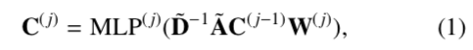
If we know the structure...
Use Graphical Convolutional Networks
Multiple hidden layers between each convolution

Slide 163
If we don’t know the structure...
Use Transformer
Encoder with single-head attention

Slide 164
In fact, GCN is a special case where attention is replaced by single head matrix
Transformer as a base algorithm is a natural choice

Slide 165
Transformer must search the entire attention space to discover meaningful connections between encounter features
GCT (Graph Convolutional Transformer) restricts search to space likely containing meaningful attention distribution
Characteristic of EHR data
Conditional probabilities between features

Slide 166
Some connections are not allowed: treatment nodes cannot connect to other treatment nodes and can only be connected to diagnosis codes
Create a mask M used during attention generation step:
0: allowed connections
-inf: not allowed connections

Slide 167
Conditional probabilities are useful as well:
E.g. chest pain, fever, EKG. Not sure if diagnosis is the reason for ordering EKG
Without structure information
Can calculate and compare p(EKG| chest pain) and p(EKG | fever), and see which connection pair is more likely
For a triple (m, d, r): calculate all m|d, d|m, r|m, m|r

Slide 168
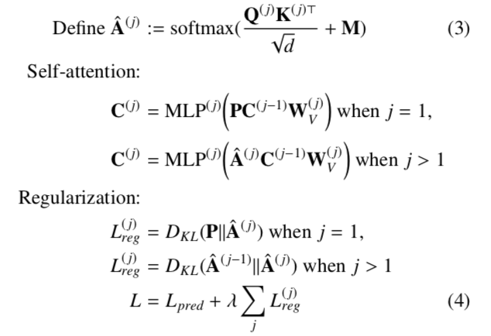
Guide GCT to recover the true graph structure
Allow rome rooms to learn new connections as well

Slide 169
Replace with the attention mechanism in the first GCT block with the conditional probabilities P
We do not want GCT to drastically deviate from P but improve upon it
Sequentially penalize attention of j-th block if it deviates too much from attention of j-1 th using KL divergence
Regularization terms summed to the prediction loss term, trade-off controlled by coefficient

Slide 170
Experiments
No public EHR data that contains structure information.
So generation of data necessary
Synthetic Data: visit-diagnosis-treatment-lab results hierarchy as EHR, in a top down fashion
Conditioned on the previous level modeled with Pareto distribution

Slide 171
On real-world EHR records
Philips eICU Collaborative Research Dataset
ICU records in US from 2014 to 2015
Encounter records: medical orders and procedure orders
Data collected from an ICU, a single encounter can last several days
Use Counters less than 254 hours
Did not use the lab results as their values change over time in the ICU

Slide 172
Prediction Tasks
Evaluate the impact of jointly learning the encounter structure, we use prediction tasks based on a single encounter rather than a sequence of encounters
GCY combined with RNN and CNN to handle sequence encounters and derive patient representations for patient-level prediction tasks

Slide 173
Prediction Performance
Graph reconstruction performance
GCN shows the best performance
GCT superior performance - readmission benefits from using latent encounter but not so for mortality prediction. Still GCT outperforms

Slide 174
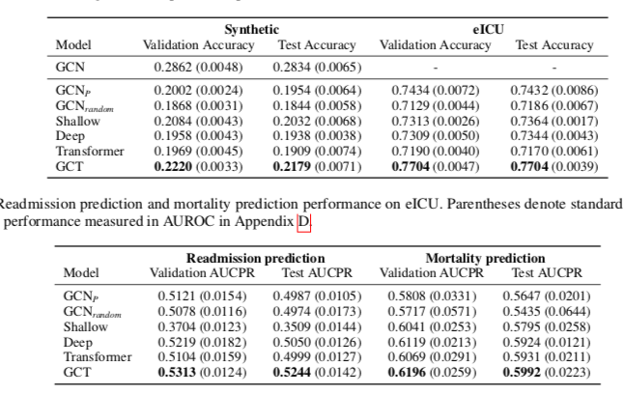

Slide 175
Learned Encounter Structure
Conditional probabilities closer to true structure than what transformer has learned in all three tasks

Slide 176
Attention Behavior Visualization
Graph Reconstruction: choose an encounter record from the test set of synthetic dataset
Attention distribution of a specific code, choose the first diagnosis code connected to at least one treatment
GCT starts with specific attention distribution as opposed to transformer.

Slide 177
DISCUSSION QUESTIONS

Slide 178
QUESTION 1
What other NLP techniques do you think are useful in EHR-related tasks?

Slide 179
QUESTION 2
Interpretability is an important issue especially in medical NLP. What are some other ways to better make findings from neural models more interpretable?

